Slide 1
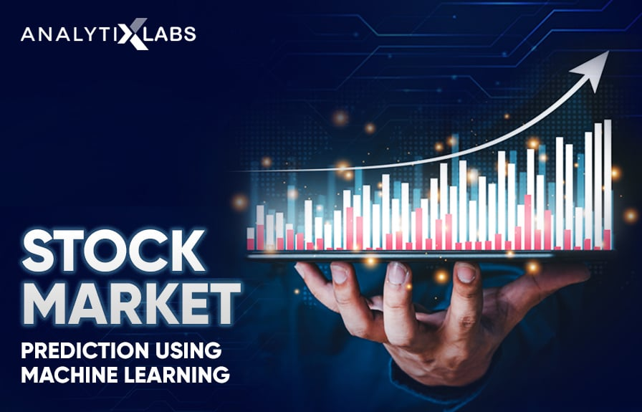
NARESH R
RECURRENT NEURAL NETWORK
(RNN)
3/21/2024 Annual Review

Slide 2
GOOGLE STOCK PRICE PREDICTION USING RNN
In the vast and dynamic realm of financial markets, where fortunes rise and fall with the tick of each trading second, the quest to forecast stock prices has always been paramount. Among the titans of the market, Google, with its unparalleled reach and influence, stands as a beacon for investors worldwide. Harnessing the power of cutting-edge technology, particularly Recurrent Neural Networks (RNNs), offers a promising avenue for deciphering the intricate patterns underlying Google's stock behavior. As we delve into the realm of RNNs, we embark on a journey to unlock the secrets hidden within the labyrinth of historical market data, striving to chart a course towards more informed and effective investment strategies. Join us as we navigate the tumultuous seas of financial markets, guided by the innovative capabilities of RNNs, in our pursuit of predicting Google's stock prices with greater accuracy and foresight.
3/21/2024 Annual Review

Slide 3


AGENDA
1. PROBLEM STATEMENT
2. PROJECT OVERVIEW
3. WHO ARE THE END USERS?
4. YOUR SOLUTION AND ITS VALUE PROPOSITION
5. THE WOW IN YOUR SOLUTION
6. MODELLING
7. RESULTS
3/21/2024 Annual Review

Slide 4

PROBLEM STATEMENT
The aim of this project is to employ Recurrent Neural Networks (RNNs) to predict Google's stock prices. Despite the abundance of historical market data, accurately forecasting stock prices remains challenging due to market complexity and volatility. Traditional methods often struggle to capture the nonlinear relationships and temporal dependencies in stock price data. RNNs offer a promising solution by leveraging their ability to learn from sequential data and capture patterns over time. This study seeks to develop, implement, and evaluate an RNN-based model to effectively predict Google's stock prices, offering valuable insights for investors and financial analysts navigating the unpredictable terrain of stock trading.
3/21/2024 Annual Review

Slide 5

PROJECT OVERVIEW
This project focuses on employing Recurrent Neural Networks (RNNs) to predict Google's stock prices. Beginning with data collection from reliable sources, the historical stock price data undergoes preprocessing to ensure its suitability for training the RNN model. The core of the project lies in implementing and optimizing the RNN model architecture, such as LSTM or GRU, to capture temporal dependencies effectively. Following training and validation, the model's performance is evaluated using relevant metrics. Ultimately, the project aims to deploy a reliable tool for investors and analysts, facilitating informed decision-making in the dynamic landscape of stock trading.
3/21/2024 Annual Review

Slide 6

WHO ARE THE END USERS?
Financial analysts, data scientists, and researchers who are directly involved in processing and analyzing financial data to improve predictive models. Portfolio managers and traders who rely on accurate data preprocessing techniques for informed decision-making would also find this topic relevant.
This topic caters to a broad audience interested in understanding the fundamentals of RNNs and their specific application in predicting stock prices. This includes investors, financial analysts, traders, portfolio managers, researchers, and even general enthusiasts curious about machine learning in finance
3/21/2024 Annual Review

Slide 7

YOUR SOLUTION AND ITS VALUE PROPOSITION
Our innovative approach utilizes Recurrent Neural Networks (RNN) to forecast Google stock prices with remarkable precision. Through comprehensive data preprocessing and sophisticated model training, we ensure accurate predictions. Investors benefit from reduced risk exposure, informed decision-making, and efficient time utilization. Our solution adapts to market dynamics, providing a robust foundation for optimized portfolio management and financial success.
Value Proposition: Our solution offers a multitude of benefits to investors and financial professionals:
1.Accurate Predictions
2.Risk Mitigation
3.Time Efficiency
3/21/2024 Annual Review

Slide 8

THE WOW IN YOUR SOLUTION
Our revolutionary approach to Google stock price prediction using Recurrent Neural Networks (RNNs) introduces a paradigm shift in investment strategy. By seamlessly integrating cutting-edge AI technology with financial analysis, we deliver unparalleled accuracy and foresight in forecasting stock prices. This fusion of data science and finance not only optimizes investment decisions but also opens new avenues for navigating the complexities of the stock market with confidence and precision. Harnessing the power of RNNs, our solution empowers investors to stay ahead of the curve, unlocking a world of possibilities for maximizing returns and achieving financial success.
3/21/2024 Annual Review
8

Slide 9
MODELLING
Teams cam add wireframes
1.Prediction Input: A clean interface allowing users to input parameters such as date range and prediction horizon with intuitive dropdown menus and text fields.
2. Prediction Results: Clear visualization of predicted stock prices alongside historical data, presented in a concise and easy-to-understand manner.
3. Alerts: Simple toggles or checkboxes for setting up personalized alerts based on specific price thresholds or events.
4. Portfolio Management: Basic portfolio overview displaying current holdings and performance metrics, with options for adding or removing stocks.
5. News Integration: A news feed section providing relevant market insights and updates, seamlessly integrated within the interface.
3/21/2024 Annual Review
9

Slide 10
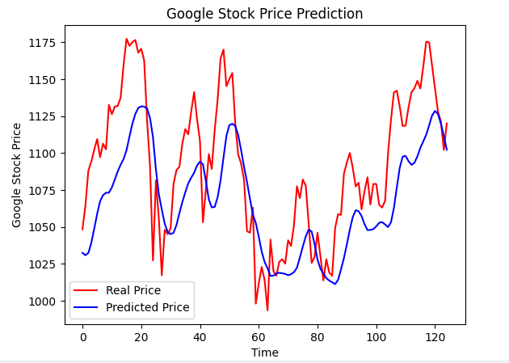
RESULTS
3/21/2024 Annual Review
10

